Slide 1
Pre-owned Car Prediction Analysis
Subject: Data 606(Capstone Project)
Professor: Chaojie Wang
Presentor: Harshavardhan Kalagarla

Slide 2
Agenda
01. Introduction
02. Data
Introduction to the project
Data cleaning , Data Visualizations are done
03. Data encoding
04. Model Training
05. Prediction
Data is classified into simpler terms for model training
Data is split and trained with the models
Suitable model is considered and predicted
November 2, 2023

Slide 3

Introduction
Car price prediction, driven by data analysis and machine learning, is essential in today's automotive industry. It helps buyers and sellers make informed decisions by estimating a vehicle's value based on factors like make, model, mileage, and market demand. This process benefits consumers, sellers, and industry stakeholders alike.
November 2, 2023

Slide 4
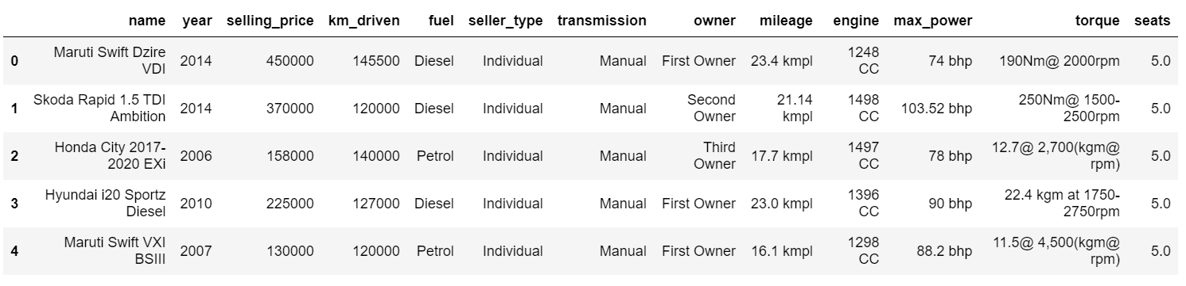
Data Information
This data is referred from Kaggle
(https://www.kaggle.com/datasets/nehalbirla/vehicle-dataset-from-cardekho?select=car+data.csv)
Data Size(299KB)
Data shape (8129 rows ,13 colums)

Slide 5
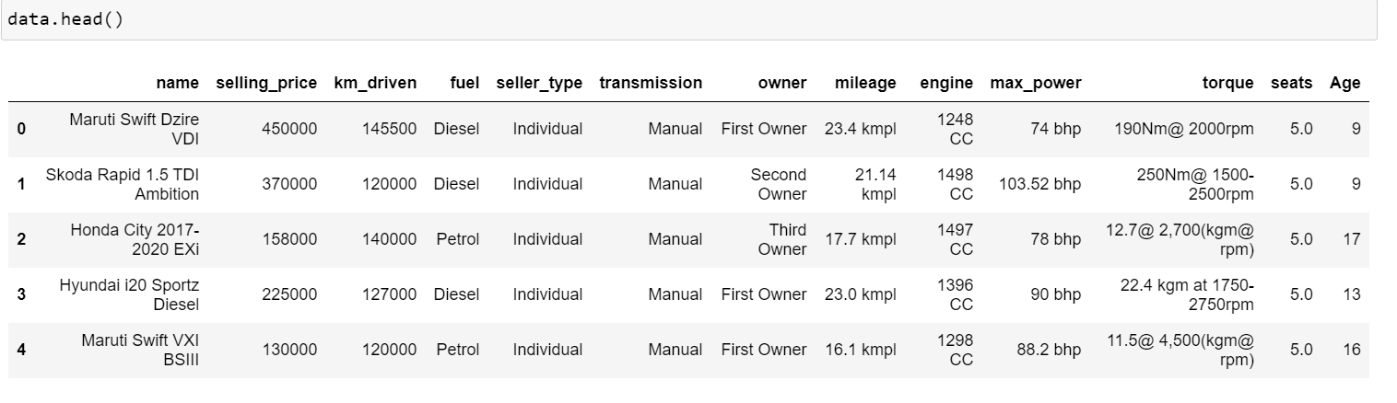
Data Cleaning
Used command like dtypes() , data.isnull().sum() to know about the data.
For clear picture of data we got a column named age from year.

Slide 6
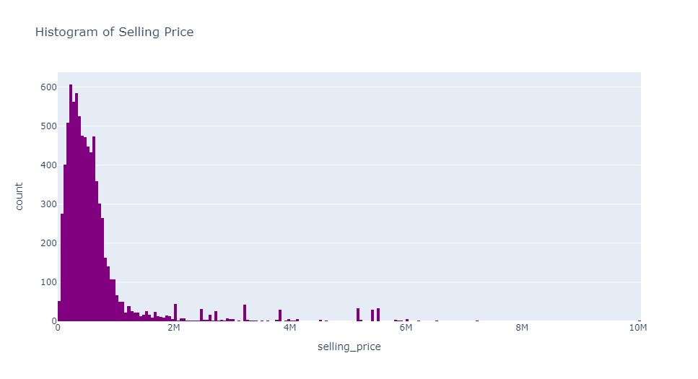
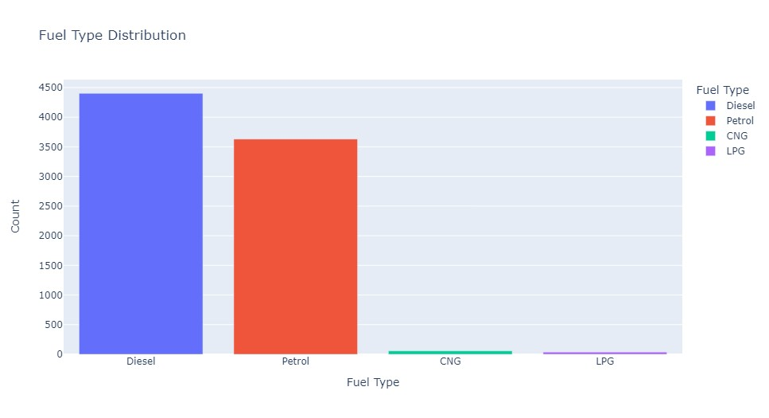
Data Visualization

Slide 7
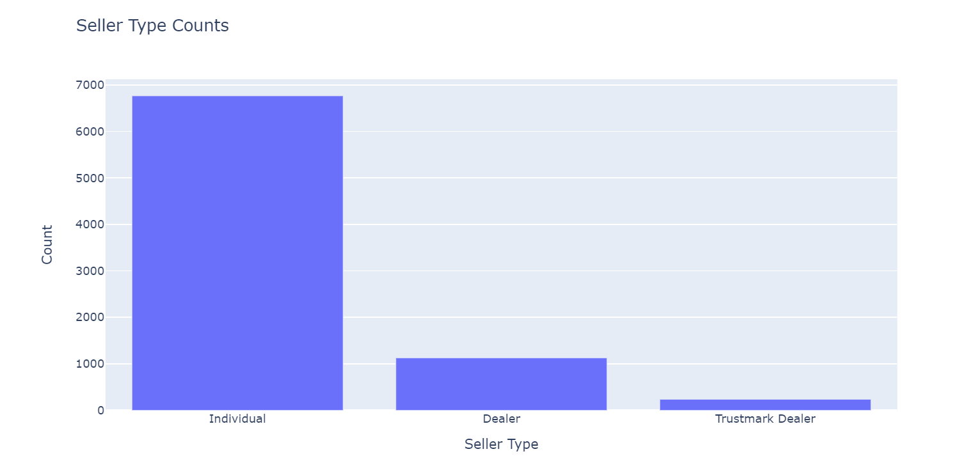
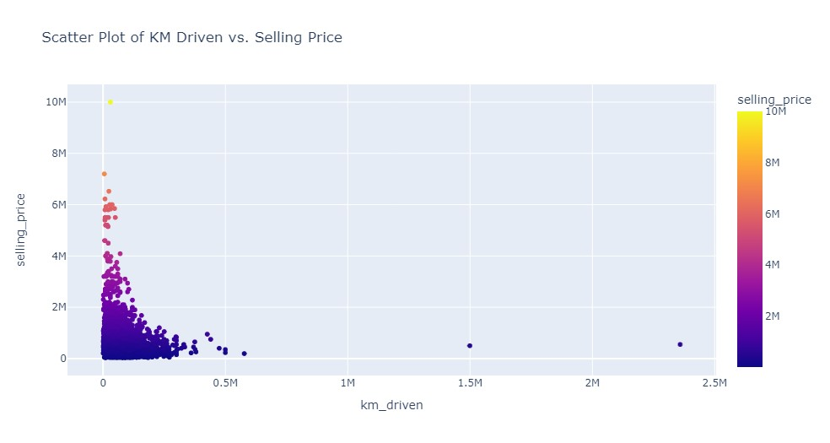
Data Visualization

Slide 8
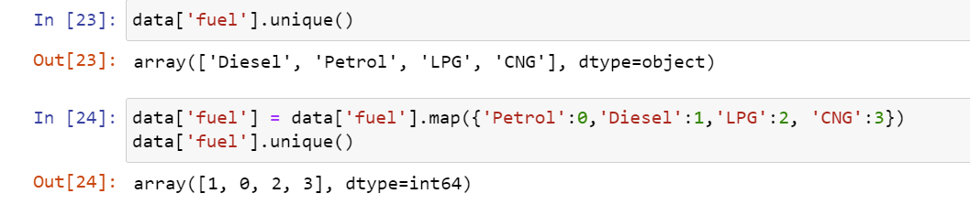
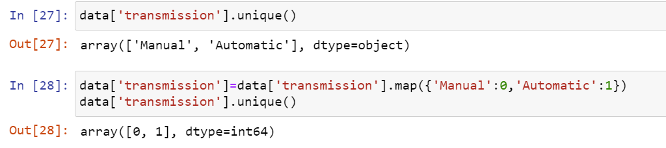
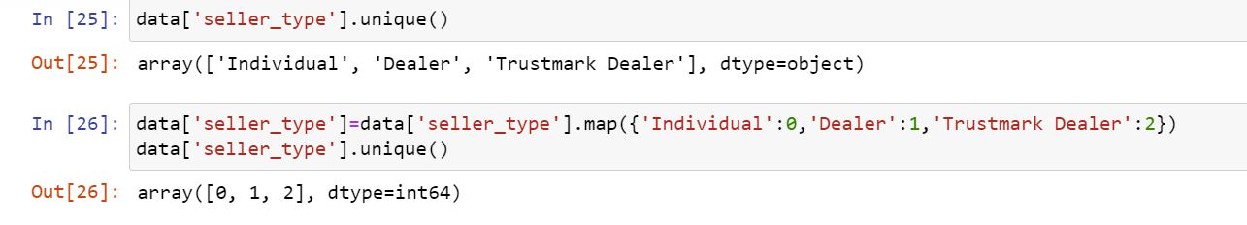
Data Encoding
Categoring the columns like fuel,seller_type,transmission and Owner and assigning the binary values do the prediction for the models would be easy and as the data types of the colums mileage,engine,max_power,torque are in object so changed it to float

Slide 9
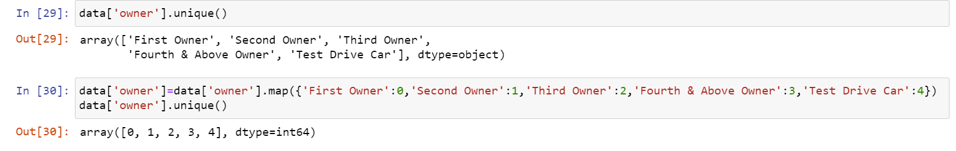
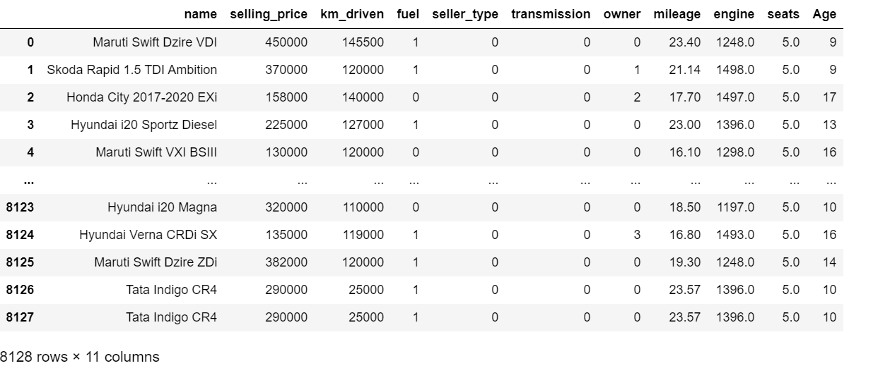
Data Encoding

Slide 10
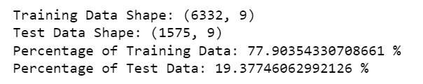
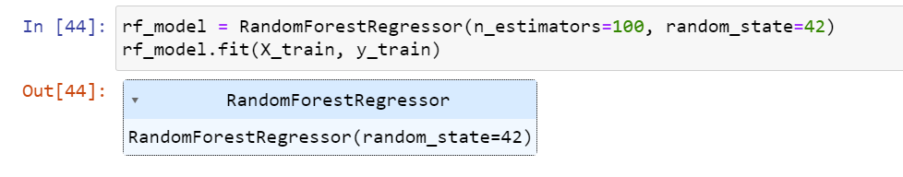
Model Training and Model Evaluation
Firstly the data is split to test and train data
To predict and use the actual accuracy we used 5 four models
Random Forest: An ensemble learning method that combines multiple decision trees to improve predictive performance.

Slide 11
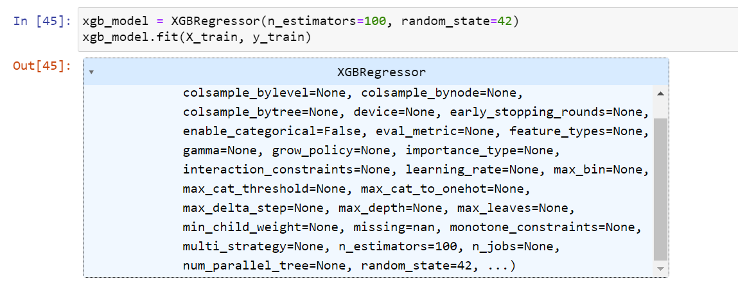
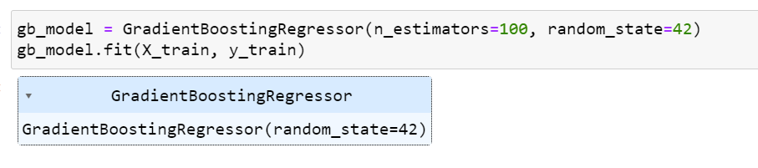
Model Training and Model Evaluation
Gradient Boosting Models (e.g., XGBoost, LightGBM): Ensemble learning techniques that build multiple weak learners sequentially, with each one trying to correct the errors of the previous one.

Slide 12
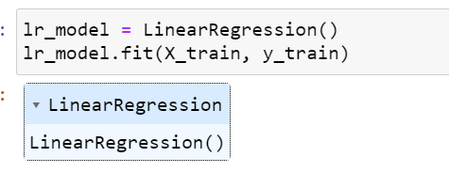
Model Training and Model Evaluation
Linear Regression: Used for predicting a continuous target variable based on one or more input features. It assumes a linear relationship between the features and the target.

Slide 13
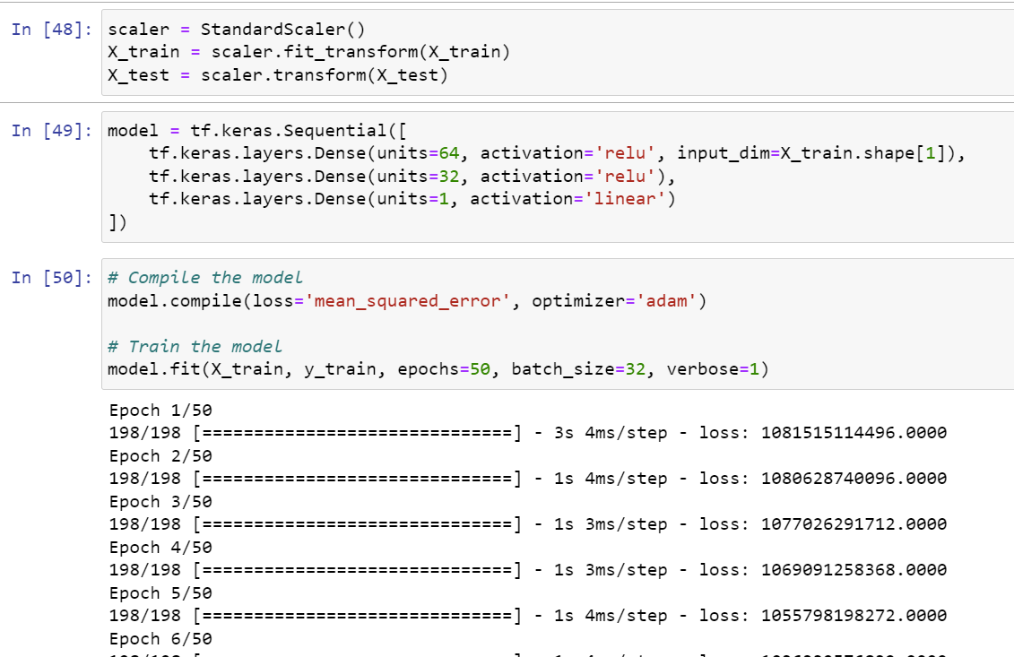
Model Training and Model Evaluation
Data scaling, neural network creation (regression), and model training using TensorFlow for 50 epochs with mean squared error loss.

Slide 14
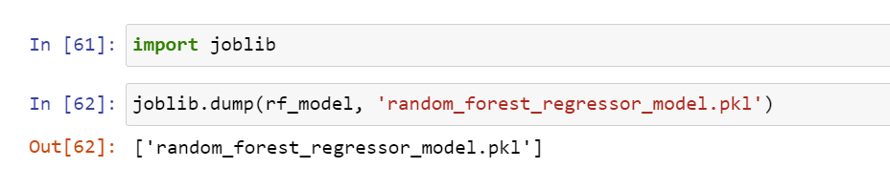
Saving and Predicting Model
Among the predictions we found Random forest was giving more accuracy than the other.

Slide 15
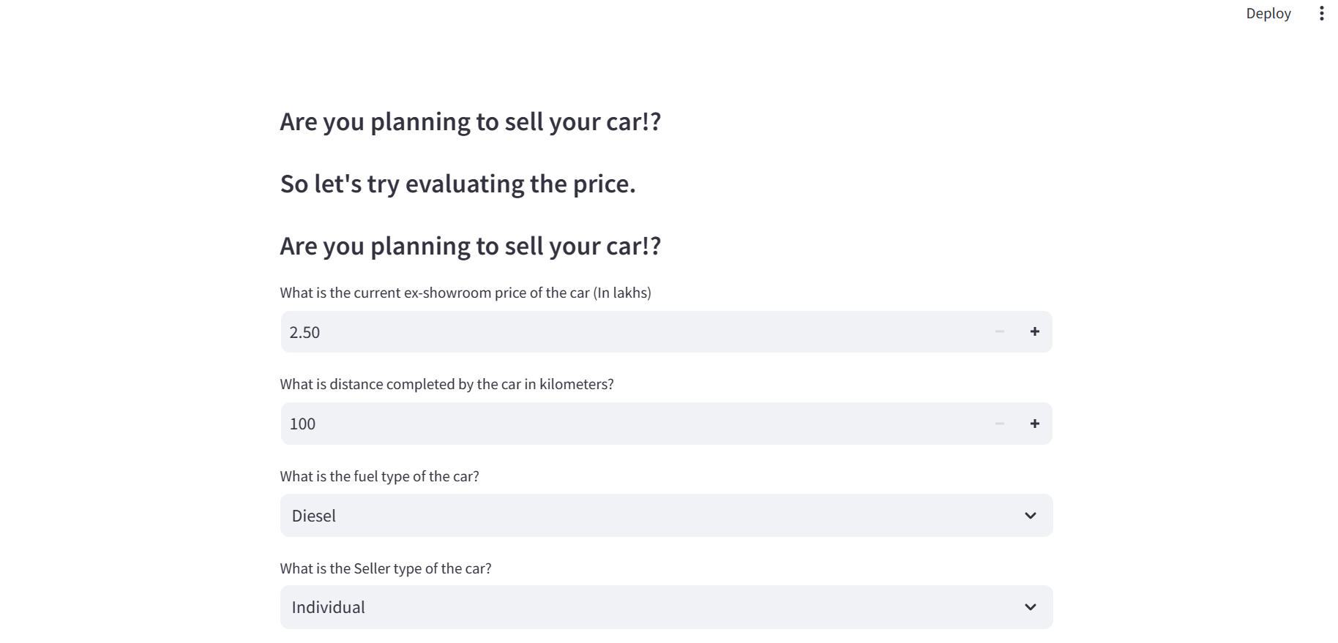
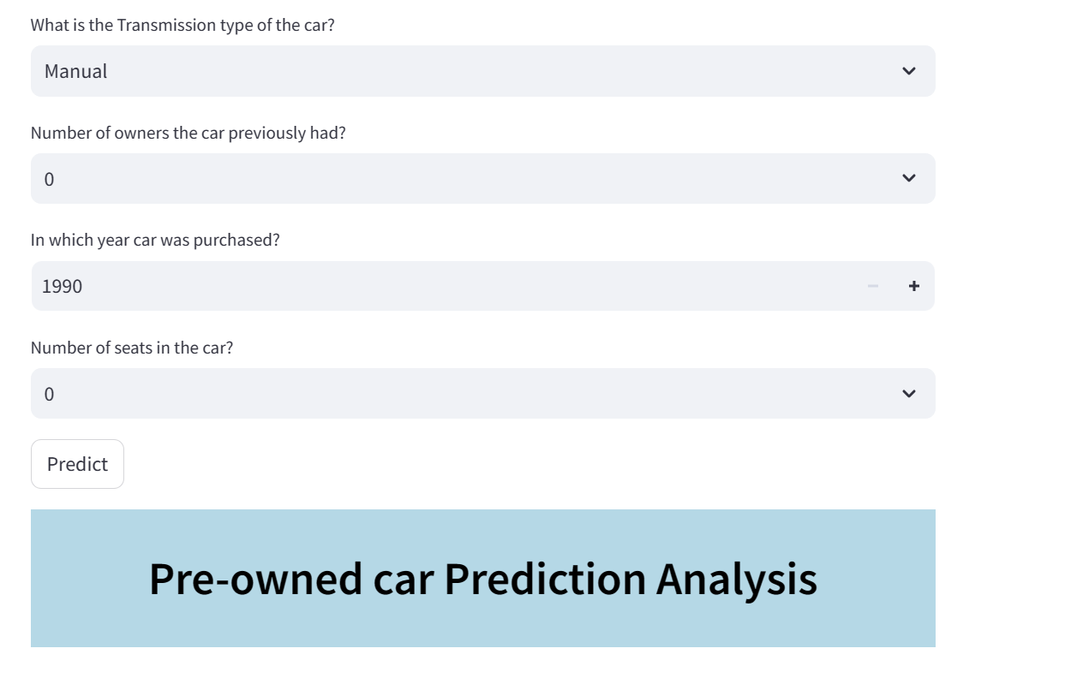
Web Page

Slide 16
Conclusion
Evaluate the performance of the deep neural network model.
Visualize and interpret the data distribution to identify potential patterns.
Explore ensemble methods to combine model predictions for better results.

Slide 17
Thank you!!!
Any Questions??

